Slide 1

Continuous Random Variable
Dr Rakhee Chhibber

Slide 2
Introduction to Continuous Random Variable
A continuous random variable has two main characteristics:
the set of its possible values is uncountable;
we compute the probability that its value will belong to a given interval by integrating a function called probability density function.

Slide 3


Definition
A random variable X is said to be continuous if and only if the probability that it will belong to an interval [a,b] can be expressed as an integral:
where the integrand function is called the probability density function of .

Slide 4
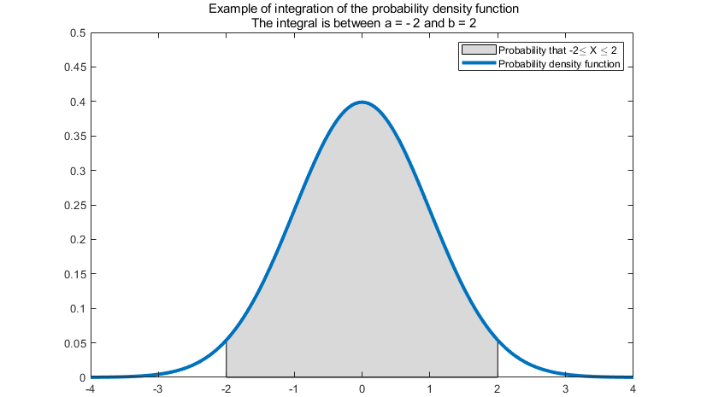

Slide 5
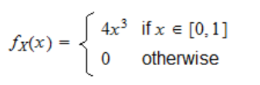
Example 1
Let X be a continuous random variable that can take any value in the interval .
Let its probability density function be
for example, the probability that X takes a value between 1/2 and 1 can be computed as follows:

Slide 6
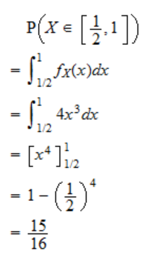
Solution

Slide 7
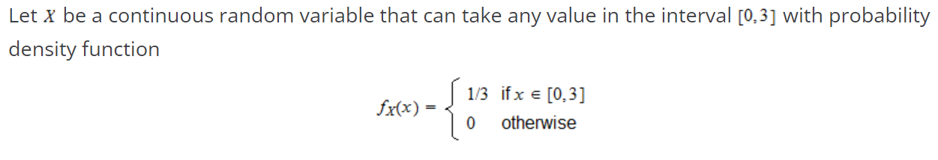
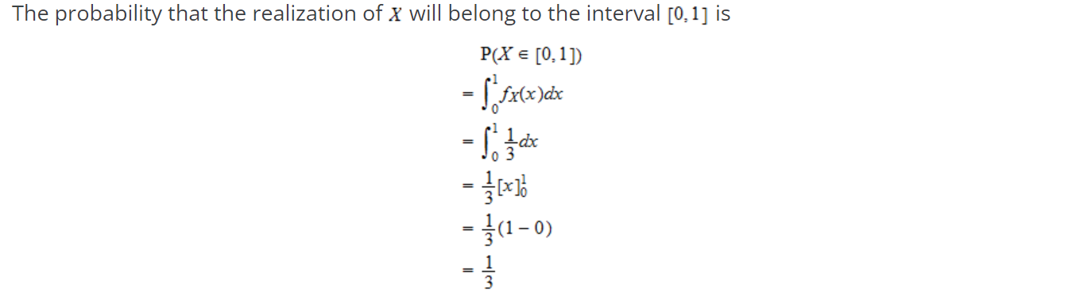

Slide 8
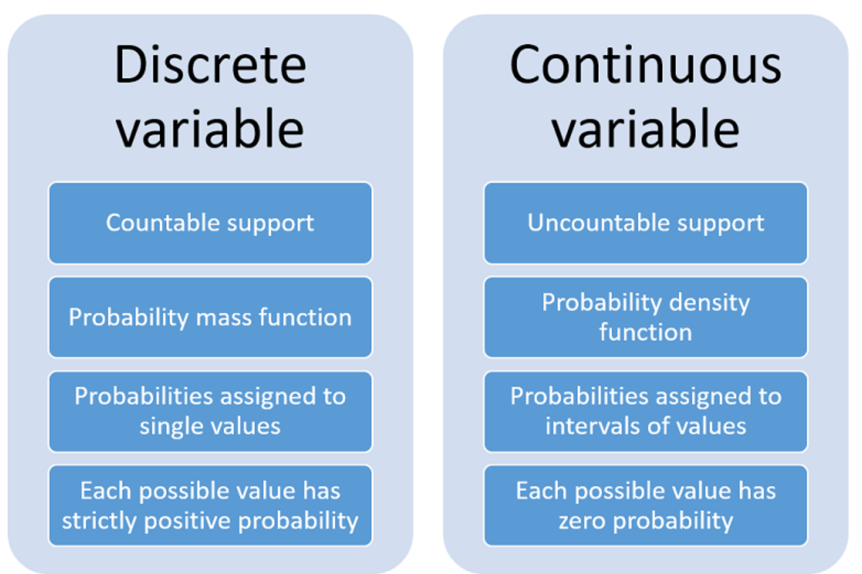

Slide 9
Introduction
These variable takes on an infinite number of values. The probability function associated with it is said to be PDF (Probability Density Function.
PDF (Probability Density Function)
If X is a continuous random variable. P (x < X < x + dx) = f(x)dx then,
  0 ≤ f(x) ≤ 1; for all x
  ∫ f(x) dx = 1 over all values of x
Then P (X) is said to be a PDF of the distribution.

Slide 10
Probability Distribution Function
It is a function in mathematics that gives the probability of all the possible outcomes of any event. We define probability distribution as how all the possible probabilities of any event are allocated over the distinct values for an unexpected variable.
Two functions are used to describe the Probability Distribution of the function which includes, Probability Mass Function and Probability Distribution Function. Here in this article, we will learn about the Probability Distribution Function. There are two ways to represent the data, Discrete Data and Continuous Data, and based on that we can represent the Probability Distribution Function into two further categories.

Slide 11
Continuous Random Variables Example
Find the value of P (1 < X < 2)
Such that,
f(x) = kx³; 0 ≤ x ≤ 3 = 0
Otherwise f(x) is a density function.

Slide 12
Solution
If a function f is said to be a density function, then the sum of all probabilities is equal to 1.
Since it is a continuous random variable Integral value is 1 overall sample space s.
∫ f(x) dx = 1
∫ kx³ dx = 1
k[x⁴]/4 = 1
Given interval, 0 ≤ x ≤ 3 = 0
k[3⁴ – 0⁴]/4 = 1
k(81/4) = 1
k = 4/81
Thus,
P (1 < X < 2) = k×[X⁴]/4
P = 4/81×[16-1]/4
P = 15/81

